Slide 1
What is Ajax ?
Ajax

Slide 2
What is Ajax ?
Welcome to the world of Ajax, the technology that lets Web software act like desktop software. One of the biggest problems with traditional Web applications is that they have that “Web” feel — you have to keep clicking buttons to move from page to page, and watch the screen flicker as your browser loads a new Web page.

Slide 3
What is Ajax ?
So how does Ajax do its stuff? The name Ajax is short for Asynchronous JavaScript and XML, and it’s made up of several components:
_x0002_ Browser-based presentation using HTML and Cascading Style Sheets (CSS)
_x0002_ Data stored in XML format and fetched from the server
_x0002_ Behind-the-scenes data fetches using XMLHttpRequest objects in the browser
_x0002_ JavaScript to make everything happen

Slide 4
What is Ajax ?
Here’s an overview of how Ajax
works:
1. In the browser, you write code in JavaScript that can fetch data from the server as needed.
2. When more data is needed from the server, the JavaScript uses a special item supported by browsers, the XMLHttpRequest object, to send a request to the server behind the scenes — without causing a page refresh.

Slide 5
What is Ajax ?
The JavaScript in the browser doesn’t have to stop everything to wait for that data to come back from the server. It can wait for the data in the
background and spring into action when the data does appear (that’s called asynchronous data retrieval).
3. The data that comes back from the server can be XML or just plain text if you prefer. The JavaScript code in the browser can read that data and put it to work immediately.

Slide 6
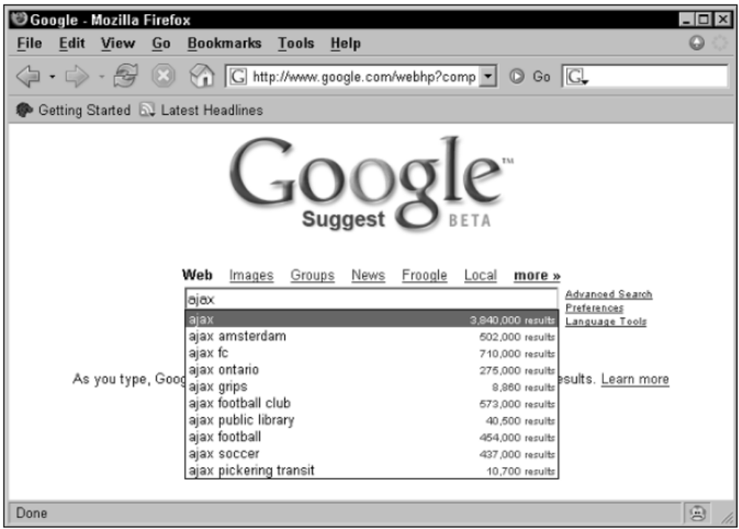
What is Ajax ?

Slide 7
Taking a look at the code
<html>
<head>
<title>Ajax at work</title>
<script language = "javascript">
var XMLHttpRequestObject = false;
if (window.XMLHttpRequest) {
XMLHttpRequestObject = new XMLHttpRequest();
} else if (window.ActiveXObject) {
XMLHttpRequestObject = new ActiveXObject("Microsoft.XMLHTTP"); }

Slide 8
Taking a look at the code
function getData(dataSource, divID){
if(XMLHttpRequestObject) {
var obj = document.getElementById(divID);
XMLHttpRequestObject.open("GET", dataSource);
XMLHttpRequestObject.onreadystatechange = function() {
if (XMLHttpRequestObject.readyState == 4 &&
XMLHttpRequestObject.status == 200) {
obj.innerHTML = XMLHttpRequestObject.responseText;}}
XMLHttpRequestObject.send(null);}}
</script>

Slide 9
Taking a look at the code
</head>
<body>
<H1>Fetching data with Ajax</H1>
<FORM>
<INPUT TYPE="BUTTON" VALUE="CLICK" onclick = "getData('data.txt','targetDiv')">
</FORM>
<div id="targetDiv">
<p>The fetched data will go here.</p>
</div>
</body>
</html>

Slide 10
Introduction
Microsoft ASP.NET AJAX enables you to quickly create Web pages that include a rich user experience with responsive and familiar user interface (UI) elements. ASP.NET AJAX provides client-script libraries that incorporate cross-browser ECMAScript (JavaScript) and dynamic HTML (DHTML) technologies, and it integrates them with the ASP.NET 2.0 server-based development platform.

Slide 11
Introduction
ASP.NET AJAX applications offer:
Improved efficiency by performing significant parts of a Web page's processing in the browser.
Familiar UI elements such as progress indicators, tooltips, and pop-up windows.
Partial-page updates that refresh only the parts of the Web page that have changed.
Client integration with ASP.NET application services for forms authentication and user profiles.

Slide 12
Introduction
ASP.NET AJAX applications offer:
Integration of data from different sources through calls to Web services.
A framework that simplifies customization of server controls to include client capabilities.
Support for the most popular and generally used browsers, which includes Microsoft Internet Explorer, Mozilla Firefox, and Apple Safari.

Slide 13
ASP.NET AJAX Architecture
ASP.NET AJAX consists of client-script libraries and of server components that are integrated to provide a robust development framework. In addition to ASP.NET AJAX, you can use the ASP.NET AJAX Control Toolkit and the features in the ASP.NET AJAX Futures releases, which are both community supported.

Slide 14
ASP.NET AJAX Server Architecture
The ASP.NET AJAX server controls consist of server and client code that integrate to produce AJAX-like behavior. The following list describes the most frequently used ASP.NET AJAX server controls.
ScriptManager Manages script resources for client components, partial-page rendering, localization, globalization, and custom user scripts. The ScriptManager control is required in order to use the UpdatePanel, UpdateProgress, and Timer controls.

Slide 15
ASP.NET AJAX Server Architecture
UpdatePanel Enables you to refresh selected parts of the page, instead of refreshing the whole page by using a synchronous postback.
UpdateProgress Provides status information about partial-page updates in UpdatePanel controls.
Timer Performs postbacks at defined intervals. You can use the Timer control to post the whole page, or use it together with the UpdatePanel control to perform update at define interval.

Slide 16
ASP.NET AJAX Server Architecture
To enable ASP.NET AJAX functionality for an ASP.NET Web page, you must add an <asp:ScriptManager> control to the page. When the page is rendered, the appropriate script references to ASP.NET AJAX libraries are generated automatically. The following example shows a page with an <asp:ScriptManager> control.
<asp:ScriptManager runat="server" ID="scriptManager" />

Slide 17
ScriptManager Class
The ScriptManager control is central to Microsoft ASP.NET 2.0 AJAX Extensions. The control manages all ASP.NET AJAX resources on a page. This includes downloading Microsoft AJAX Library scripts to the browser and coordinating partial-page updates that are enabled by using UpdatePanel controls.

Slide 18
ScriptManager Class
In addition, the control enables you to do the following:
Register script that is compatible with partial-page updates. Any script that you register is loaded after the Microsoft AJAX Library script to manage dependencies between your script and the core library.
Configure whether release or debug scripts are sent to the browser.
Access Web service methods from script by registering Web services with the control.
Access ASP.NET authentication and profile application services from client script by registering these services with the control.

Slide 19
UpdatePanel Control Overview
ASP.NET UpdatePanel controls enable you to build rich, client-centric Web applications. By using UpdatePanel controls, you can refresh selected parts of the page instead of refreshing the whole page with a postback. This is referred to as performing a partial-page update. A Web page that contains a ScriptManager control and one or more UpdatePanel controls can automatically participate in partial-page updates, without custom client script.

Slide 20
UpdatePanel Control Overview
<%@ Page Language="C#" %>
<script runat="server"> </script>
<html xmlns="http://www.w3.org/1999/xhtml">
<head runat="server"> <title>UpdatePanel Example</title>
</head> <body> <form id="form1" runat="server"> <div> <asp:ScriptManager ID="ScriptManager" runat="server" /> <asp:UpdatePanel ID="UpdatePanel1" UpdateMode="Conditional" runat="server"> <ContentTemplate>
<fieldset> <legend>UpdatePanel content</legend>
<!-- Other content in the panel. -->
<%=DateTime.Now.ToString() %> <br />
<asp:Button ID="Button1" Text="Refresh Panel" runat="server" /> </fieldset> </ContentTemplate> </asp:UpdatePanel> </div> </form> </body> </html>

Slide 21
UpdatePanel Control Overview
<script runat="server">
protected void Page_Load(object sender, EventArgs e) {
UpdatePanel up1 = new UpdatePanel();
up1.ID = "UpdatePanel1";
up1.UpdateMode = UpdatePanelUpdateMode.Conditional;
Button button1 = new Button();
button1.ID = "Button1"; button1.Text = "Submit"; button1.Click += new EventHandler(Button_Click);
Label label1 = new Label();
label1.ID = "Label1"; label1.Text = "A full page postback occurred."; up1.ContentTemplateContainer.Controls.Add(button1); up1.ContentTemplateContainer.Controls.Add(label1);
Page.Form.Controls.Add(up1); }

Slide 22
UpdatePanel Control Overview
protected void Button_Click(object sender, EventArgs e) { ((Label)Page.FindControl("Label1")).Text = "Panel refreshed at " + DateTime.Now.ToString(); }
</script> <html xmlns="http://www.w3.org/1999/xhtml"> <head id="Head1" runat="server"> <title>UpdatePanel Added Programmatically Example</title> </head> <body> <form id="form1" runat="server"> <div> <asp:ScriptManager ID="TheScriptManager" runat="server" /> </div> </form> </body> </html>

Slide 23
To use an UpdatePanel control
Create a new page and switch to Design view.
In the tab of the toolbox, double-click the ScriptManager control to add it to the page.
Click inside the UpdatePanel control and then in the tab of the toolbox, double-click the Label and Button controls to add them to the UpdatePanel control.
Set the Text property of the Label to Panel created.
Double-click the Button control to add a handler for the button's event.
Add the following code to the handler, which sets the value of the label in the panel to the current time.

Slide 24
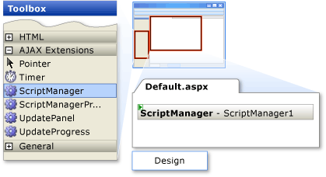
To use an UpdatePanel control

Slide 25
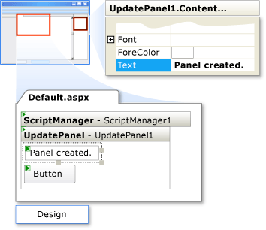
To use an UpdatePanel control

Slide 26
To use an UpdatePanel control
Protected Sub Button1_Click(ByVal sender As Object, ByVal e As System.EventArgs)
Label1.Text = "Refreshed at " & _
DateTime.Now.ToString()
End Sub

Slide 27
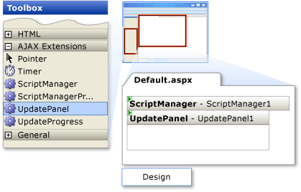
Understanding the Benefits of the UpdatePanel Control

Slide 28
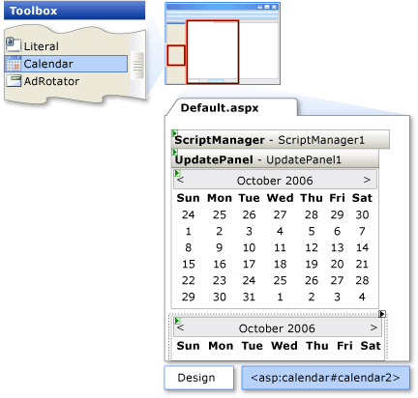
Understanding the Benefits of the UpdatePanel Control

Slide 29
Refreshing an UpdatePanel Control with an External Button
By default, a postback control (such as a button) inside an UpdatePanel control causes a partial-page update. By default, a button or other control outside an UpdatePanel control causes the whole page to be refreshed, as you have seen.
You can also configure a control outside the update panel to be a trigger that refreshes just the update panel.

Slide 30
Refreshing an UpdatePanel Control with an External Button

Slide 31
Refreshing an UpdatePanel Control with an External Button
Click inside the UpdatePanel control, and then in the Standard tab of the toolbox, double-click the Label control to add it to the UpdatePanel control.
Set the Text property of the label to Panel created.

Slide 32
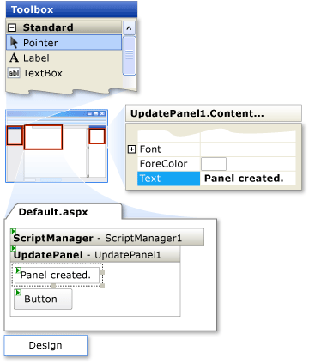
Refreshing an UpdatePanel Control with an External Button

Slide 33
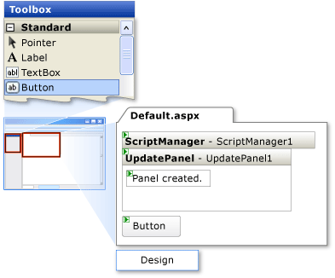
Refreshing an UpdatePanel Control with an External Button
Click outside the UpdatePanel control and then add a Button control.

Slide 34
Refreshing an UpdatePanel Control with an External Button
Double-click the Button control to add a handler for the button's Click event.
Add the following code to the Click handler, which sets the value of the label in the panel to the current time.

Slide 35
Refreshing an UpdatePanel Control with an External Button
protected void Button1_Click(object sender, EventArgs e)
{
Label1.Text = "Refreshed at " +
DateTime.Now.ToString();
}

